Slide 1
RSS – Really Simple Syndication

Slide 2
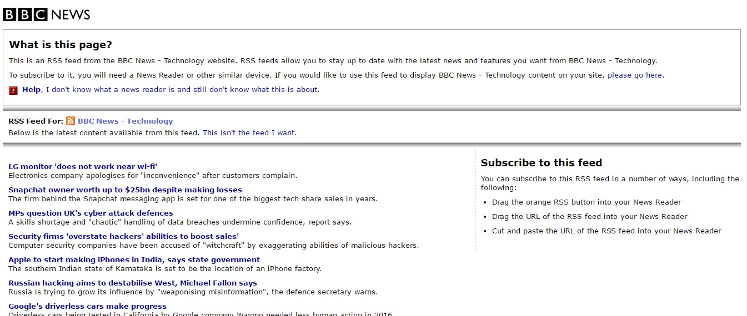

Slide 3
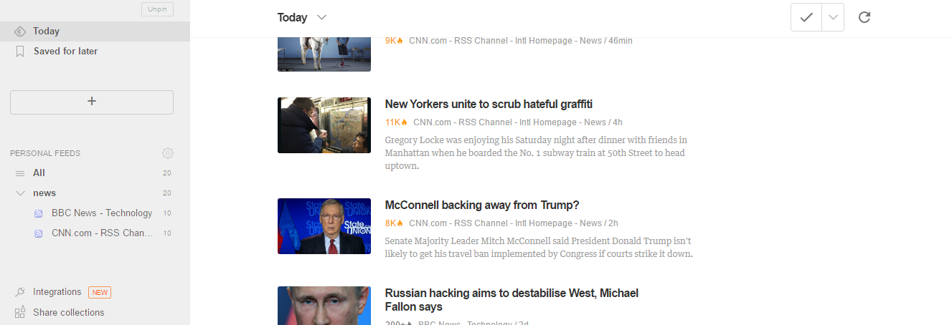

Slide 4
RSS/ Atom
The need for communication on the web in a format different from html cannot be overstated.
When servers deal with other servers or when the content of a resource becomes important, then html can no longer be sufficient.
We have JSON as a popular format because it can be directly parsed using Javascript code.

Slide 5
RSS/ Atom
But the xml is the universal standard due to its various advantages.
For situations where there are regular updates to resources on the server, the user must have a mechanism where he can avoid manual visits to the sites to check if updates have occurred.

Slide 6
RSS/ Atom
RSS is a family of feed formats to publish frequently updated data.
The feeds are read by AJAX based software called feed aggregators or feed readers or RSS readers.
The feed which is in xml format must be parsed by the reader before displaying it in html

Slide 7
How does the RSS work?
A website willing to publish information using RSS, creates an RSS feed and keeps it on a web server.
This can be manual or through software.
The feed needs to be validated by a proper software before it is published.
A website vendor will "subscribe" to read the RSS feed. The feed will be read by a Feed Reader. This can be web-based or desktop based or even mobile-device based.

Slide 8
How does the RSS work?
The Feed Reader reads the feed file and displays it. Only new items are displayed. (this is done on a periodic basis)
The Feed Reader can be customized to show content of one or more feeds depending on user interest.

Slide 9
RSS – Common Applications
Realtors - listing new homes available in an area
Job openings - Placement firms and newspapers.
Auctions
News
Entertainment - list of latest programmes or movies

Slide 10
RSS Advantages
All news at one place - subscribe to multiple news groups.
Freedom from email overload - just go to the reader and find updated news automatically.
Easier publishing – Server does not need to maintain database of subscribers. It is the subscribers responsibility.
A simpler data-writing process on the server side
Relevance and timeliness - subscribers are guaranteed to have latest info about your page.

Slide 11
RSS format
Based on DTDs.
The RSS 0.91 DTD lists 24 elements (as opposed to 10 in RSS 0.9)
Starts with <rss version="0.91">
The key elements are channel, title, link,description and item.
RSS 1.0 - more verbose than 0.91. Not so popular.
RSS 2.0 - Almost mirrors RSS 0.91, with a few minor changes.
Ex: The DOCTYPE tag is not required, new elements like <author> are included.

Slide 12
Atom
A syndication format similar to RSS. Stricter than RSS.
Inception in 2003. Reached a good shape around 2005
One of the problems of RSS is the lack of information on how a developer handles HTML markup in its elements.
ATOM's specification addresses this issue and also applies stricter rules.
You can also choose content type of an element and also specify via attributes how a specific element should be handled.

Slide 13
Atom
The data constructs are more or less similar.
One key point is that all elements in an ATOM feed must reside in the “http://www.w3.org/2005/Atom" namespace. Otherwise some parsers cannot parse the data.
The <entry> element is analogous to the <item> element in RSS
The root node is called <feed>

Slide 14
Sample RSS file
<?xml version="1.0" encoding="utf-8"?>
<rss version="2.0">
<channel>
<title>Yahoo! News - Top Stories</title>
<link>http://news.yahoo.com/topstories/</link>
<description/>
<language>en-US</language>
<copyright>Copyright (c) 2012 Yahoo! Inc. All rights reserved</copyright>
<pubDate>2012-04-02T07:46:35-04:00</pubDate>

Slide 15
Sample RSS file contd….
…..
<item>
<title>Pinnacle Airlines </title>
<description>Sample desc</description>
<link>….</link>
<author>Some reporter</author>
</item>
</rss>

Slide 16
Sample Atom feed
<feed version=”1.0” xmlns=http://www.w3.org/2005/atom>
<title>My Feed</title>
<link rel=”alternate” href=http://atomfeeds.com />
<entry>
<title>First atom feed</title>
<link rel=”alternate” href=http://firstfeed.com />
<author>myself</author>
<content>Feed description</content>
</entry>
...
</feed>

